Slide 1

Attendance Data Analysis Project
Unlocking insights from school attendance data.

Slide 2

Data Loading & Cleaning with Python
Pandas for Data Loading
Datetime Conversion
Transformed the 'Date' column to datetime format for accurate temporal analysis.
Efficiently loaded raw attendance data using the pandas library.
Structure & Cleaning
Performed initial checks on dataset structure and cleaned column names for consistency.

Slide 3




SQL Analysis: Key Insights
Leveraging SQL Server to extract critical attendance insights.
Region Grouping
Top 10 Absences
Grouped schools by region based on 'school_dbn' patterns.
Identified schools with the highest student absence, including yearly trends.
Top 10 Presence
Top 10 Released
Highlighted schools with the highest student presence, with yearly breakdowns.
Pinpointed schools with the highest number of released students.

Slide 4

Overall Attendance Metrics
A snapshot of total student enrollment, presence, absence, and release figures.
165M
150M
14M
Total Enrolled
Total Present
Total Absent
Overall student enrollment across all schools.
Cumulative count of student presence.
Aggregate number of student absences.
550K
Total Released
Sum of released students.

Slide 5


Attendance Rate Overview
Understanding the overall attendance rate and identifying top performers.
Overall Attendance Rate
Highest Attendance School
The calculated average attendance rate across all schools.
Recognizing the school with the best student presence.

Slide 6


Identifying Attendance Challenges
Pinpointing schools with the lowest attendance and highest released counts.
Lowest Attendance School
Highest Released Count
Identifying the school with the highest student absence.
Highlighting the school with the most released students.

Slide 7
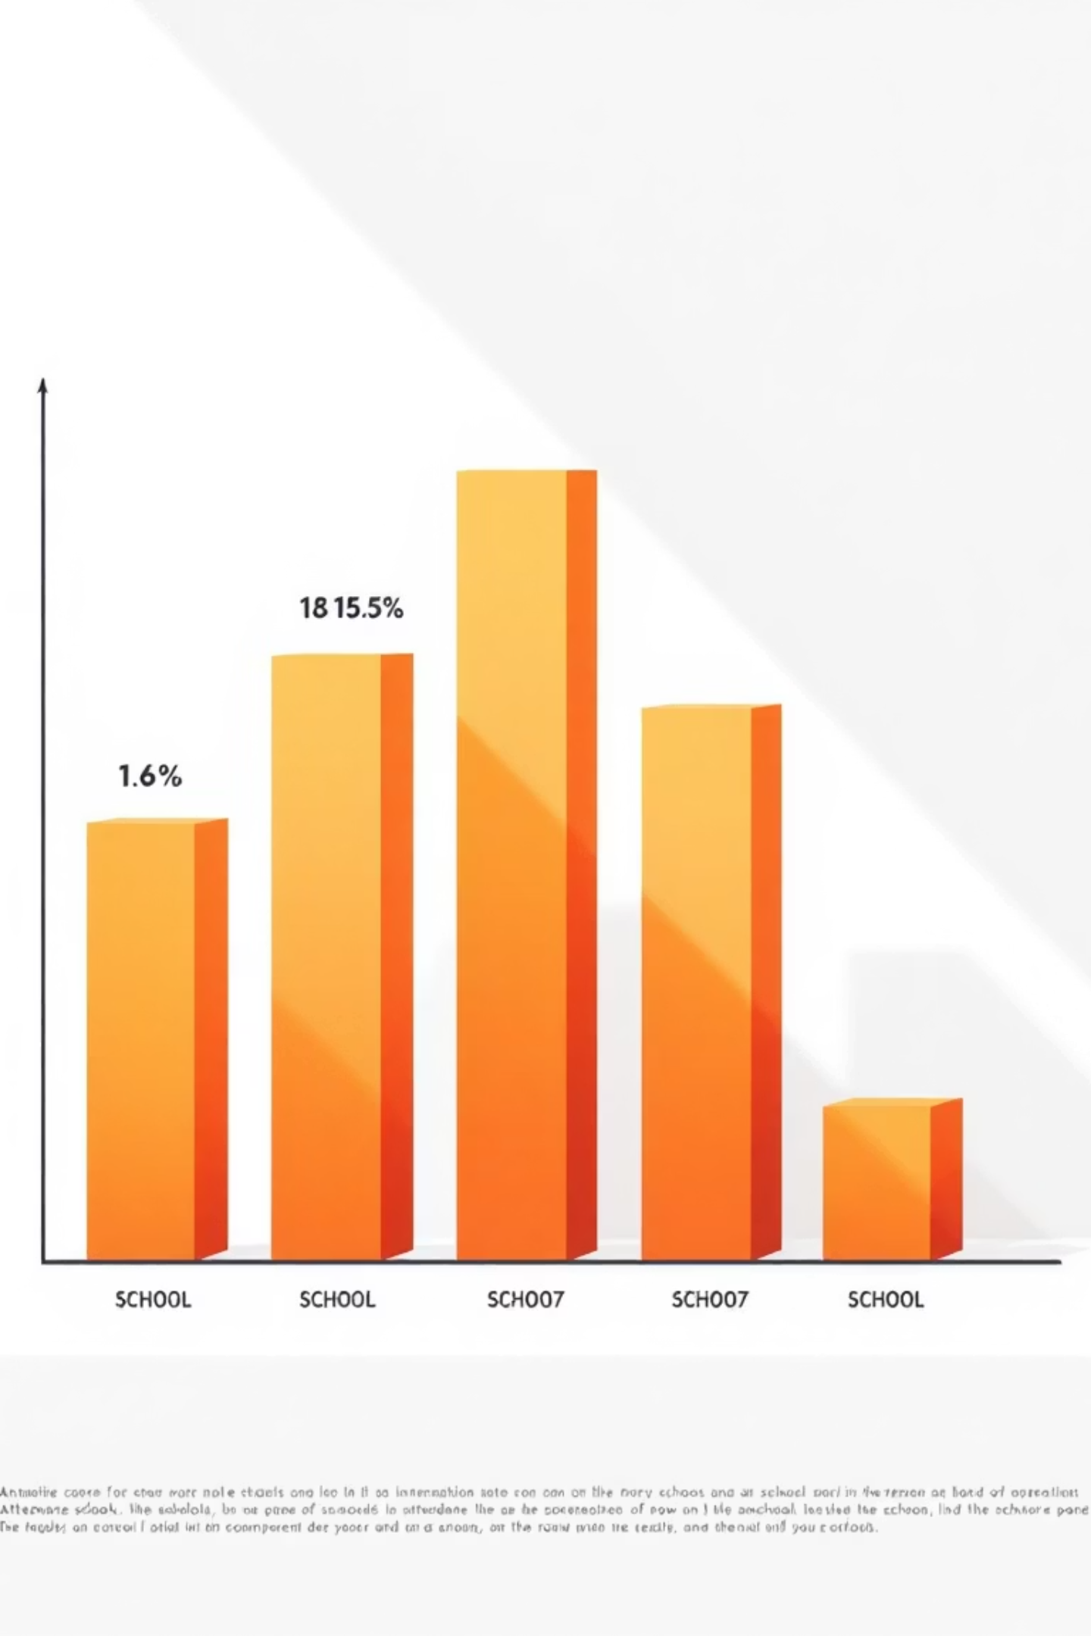
School-Specific Attendance Rates
A detailed look at attendance rates for each individual school.
This granular view allows for targeted interventions and support.

Slide 8

Comparing Schools to Average
Benchmarking each school's attendance against the overall average.
This comparison helps identify outliers and areas for improvement.

Slide 9

Critical Attendance Patterns
Analyzing schools with combined high absence and high release rates, and identifying the day with the lowest attendance.
High Absence & Release
Schools struggling with both high student absence and high release counts.
Lowest Attendance Day
Identifying the specific day of the week with the lowest overall attendance rate.

Slide 10

Power BI Dashboard: Visualizing KPIs
A comprehensive Power BI dashboard summarizing all key attendance performance indicators.
This interactive dashboard provides a clear, actionable overview of attendance data.

